Slide 1
ALGORITHM ANALYSIS & DESIGN
Submitted To: Md. Bayazid Rahman (Lecturer NDUB)
Submitted By:
Group : 1
Shazidul Alam _ 09
Anisur Rahman Naeem _ 15
Batch : CSE-19
Topic : AVL TREE
01

Slide 2
CONTENTS OF THIS TEMPLATE
Here’s what you’ll find in this template:
1) Definition 2) Steps for doing it
3) Example 4) Algorithm
5) Pseudocode 6) Working code
7) Time Complexity 8) Conclusion
02

Slide 3
What is AVL Tree?
Here's a concise definition of an AVL tree from the book "Introduction to Algorithms" by Thomas H. Cormen, Charles E. Leiserson, Ronald L. Rivest, and Clifford Stein:
An AVL tree is a self-balancing binary search tree where the heights of the two child subtrees of any node differ by at most one. This property is maintained through rotation operations performed during insertion and deletion to ensure that the tree remains balanced. As a result, the number of nodes, ensuring efficient search, insertion, and deletion operations.
03

Slide 4
How Draw of AVL Tree
The step by step process:
1) Insert the new node following the rules of a binary search tree.
2) Update the heights of ancestor nodes.
3) Check and balance any node violating the AVL property.
4) Perform rotations if necessary to restore balance.
04

Slide 5
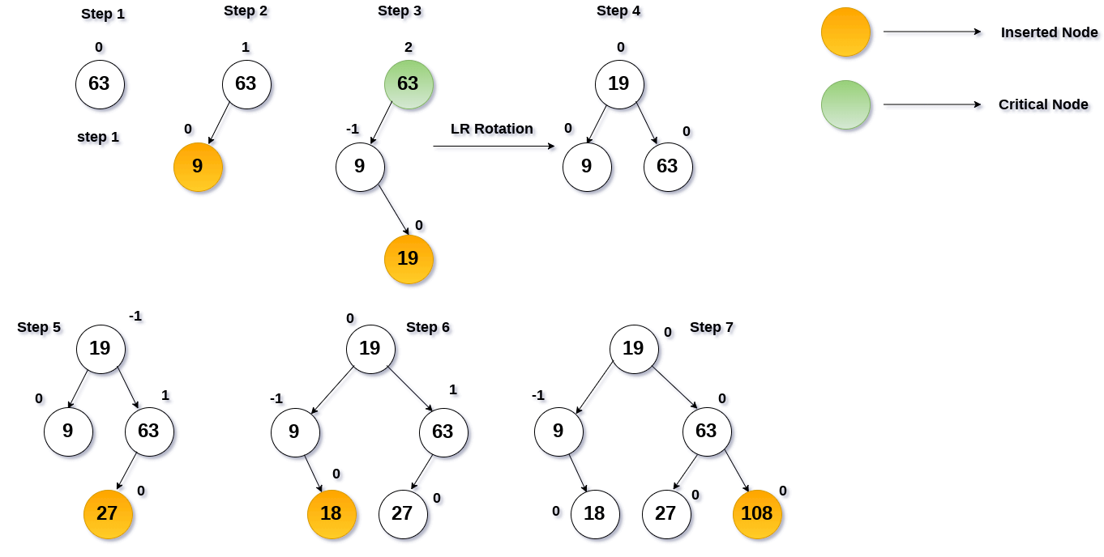
Example of AVL Tree
63, 9, 19, 27, 18, 108
05

Slide 6
Algorithm
Algorithm for AVL tree operations from the book "Introduction to Algorithms" by Thomas H. Cormen, Charles E. Leiserson, Ronald L. Rivest, and Clifford Stein:
1. If T is empty, create a new node z and return it as the root of T.
2. Perform a standard BST insertion of z into T.
3. Update the height of each node on the path from z to the root of T.
4. Balance the tree by performing rotations if necessary, starting from the lowest node with an imbalance.
06

Slide 7
Pseudocode
class Node:
def __init__(self, key):
self.key, self.left, self.right, self.height = key, None, None, 1
def height(node):
return node.height if node else 0
def isBalanced(node):
return node or abs(height(node.left) - height(node.right)) <= 1
if node is None:
return True
if abs(balance) > 1:
return False
# Example usage
root = Node(10)
root.left, root.right = Node(5), Node(15)
root.left.left, root.left.right = Node(3), Node(7)
print("Is the AVL tree balanced?", isBalanced(root))
07

Slide 8
Working Code
10, 5, 15, 3 ,7 = Is the AVL tree balanced? True
10, 5, 15, 3 , 7, 2 = Is the AVL tree balanced? False
08

Slide 9
Time Complexity
O(logn)
AVL trees guarantee logarithmic time complexity for these operations, making them efficient even for large datasets.
09

Slide 10
Conclusion
In summary, AVL trees are balanced binary search trees that maintain logarithmic height, ensuring efficient operations. Through rotations, AVL trees self-balance during insertion and deletion, providing consistent performance. With their balanced structure, AVL trees offer fast search, insertion, and deletion, making them valuable in various applications requiring efficient data structures.
10

Slide 11
Thanks
11

